Slide 1
Sticks Kabob Segmentation Analysis
Group 2 – Mar653 Marketing Analytics
JAY aTKINS, nICHOLAS lICHTSINN, aLEX nOONAN, gAVIN sCOTT, jENNIFER yANCIE

Slide 2
Who is the Customer
How do people choose a fast-food restaurant to visit?
Most prefer convenience in the form of cost and location. In the Sticks Kebob story, it suggests the younger crowd or customers with children under 13 would look to lower cost and close in location whereas the older adults may prefer more of a cuisine experience, with not so much emphasis on price and location.
Sticks Customers based on the survey:
Care about convenience, value, taste, healthy options, and consistency compared to non-sticks customers
Are not as concerned about variety, staff, ambiance and community
Customers usually in the 26-40 range with kids
Household Income level around $50,000

Slide 3
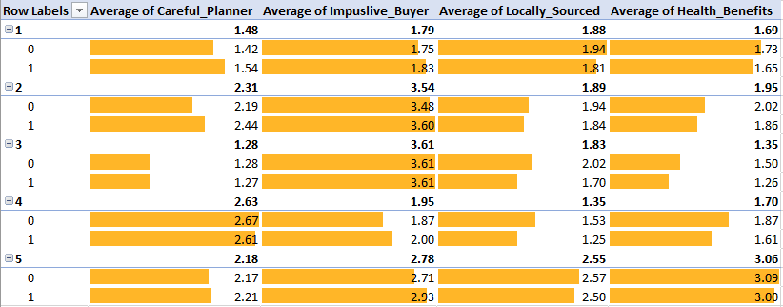
Differences Between Customers and Non-Customers
Sticks customers are much more health conscious
More business professionals and educators are customers.
Customer household income is higher, they are younger and have younger children than non-customers
Health benefits only variable close to statistically significant.
Column | Comparison Of Variance P-Value (> 0.05 -> Same Variance)
Careful Planner | 0.277
Impulsive Buyer | 0.861
Locally Sourced | 0.192
Health Benefits | 0.051

Slide 4
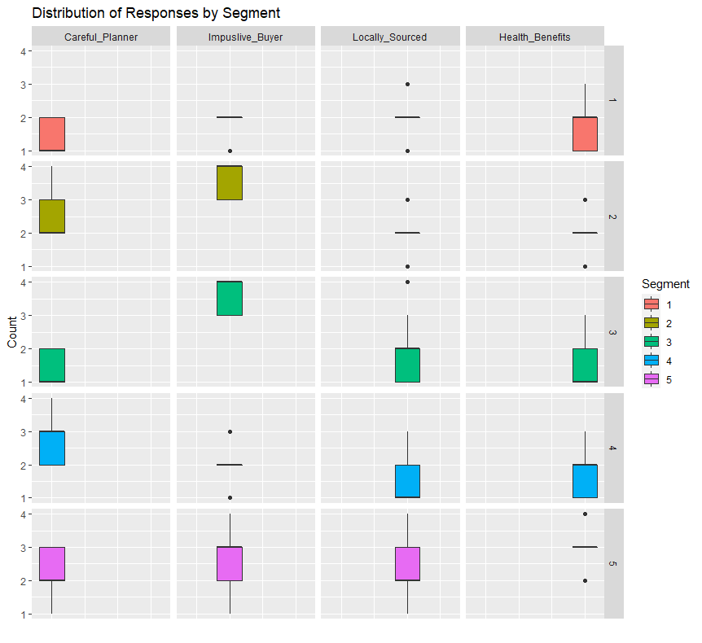
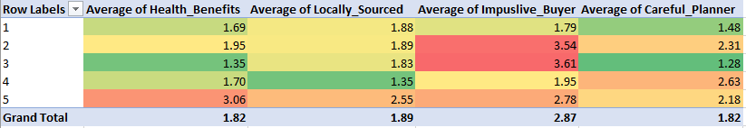
Customer Segments
K-Means results identified 5 different segments as the optimal number of groups.
Segment 1 and 3 find Health benefits and consistency the most important.
Segment 4 cares about it being locally sources as well as it being an impulse buy.
Segment 5 is indifferent across the board.

Slide 5
Questions to Identify Segments
Segment | Bases | Related Questions
1 | Psychographics | Do you prefer a healthy menu option?
2 | Past purchases and product use behavior | How many times do you plan to eat out vs actual times you eat out per week?
3 | Past purchases and product use behavior | How many times per week do you plan to eat out?
4 | Demographic | What is your approximate average annual household income?
5 | Desired benefits from products and services | What is the most important factor when deciding where to eat out?

Slide 6
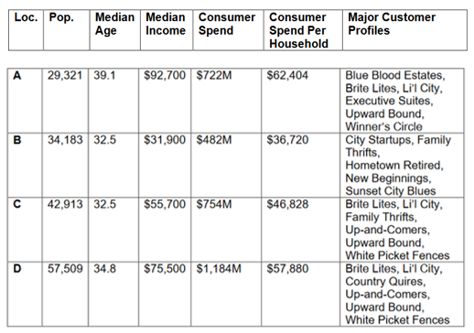
Segments to Profiles
Segments 1 and 3 focus on the health benefits and planning match the profiles relating to Up-and-Comers, Upward bound, White Picket Fences.
Segment 4 focus on local sourcing, health benefits, and impulse purchases is like Bright Lights li'l City and City Startups.
Segment 5's indifference would characterize the folks going to lunch which matches up to the Executive Suites and the Upward Bound.

Slide 7
Location Recommendation
D
Bright lights li’l city – upper midscale younger family mix
White picket fences – midscale middle age family mix
Up-and-comers – upper midscale younger family mix
Upward bound – upscale younger family mix
Country squires – wealthy middle age family mix
Higher average income, population and household spend – larger client base and more opportunity
Does not match the income level, higher earners might look for more of a dining experience than the fast casual
C
Bright lights li’l city – upper midscale younger family mix
White picket fences – midscale middle age family mix
Up-and-comers – upper midscale younger family mix
Family thrifts – low income middle age mostly w/o kids
Upward bound – upscale younger family mix
C matches the customer profile from the survey the closest, with a median income around $50,000, an younger population and a mix of young and middle age families with children.

